Slide 1

Project Specification No.46
Text Mining andSentiment Analysis Based Intelligent System for Monitoring and Evaluating Public Health Awareness Campaigns
Course Code & Name: 21CSP401L - PROJECT
Student Name: Ratakonda Mokshagna (RA2211026050011) & T Dyana Vardhan Reddy (RA2211026050024)
Branch Name & Section: CSE-AIML
Project Guide Details
Dr. C. Priyadharsini - Assistant Professor

Slide 2
Introduction
Brief Background of the Project Domain
Rapid growth of social media platforms generates massive health-related textual data
Public opinions and misinformation spread quickly during health awareness campaigns
Traditional survey-based analysis methods are slow and difficult to scale effectively
NLP and Text Mining help analyze public sentiment and misinformation automatically
Relevance of the Topic to the Core Course
Applies Artificial Intelligence and Machine Learning concepts for text classification
Uses Natural Language Processing techniques to analyze user-generated content
Implements LSTM, TF-IDF, and Logistic Regression prediction models
Demonstrates real-world analytics, visualization, and decision-support applications
Why This Project?
Health-related misinformation on social media is increasing rapidly worldwide
Existing systems mainly focus on sentiment analysis without misinformation detection
The proposed system provides early detection of negative sentiment and fake information
Helps policymakers improve public health awareness campaigns using data-driven insights

Slide 3
Problem Statement
Problem to be Solved
Public health campaigns generate massive amounts of unstructured social media data
Existing systems mainly focus only on sentiment analysis or misinformation separately
False or misleading health information spreads rapidly across social platforms
Need for an integrated system for early sentiment and misinformation detection
Real-World / Academic Significance
Social media strongly influences public perception during health crises
Traditional analysis methods fail to process large-scale real-time textual data
Demonstrates integration of NLP, Machine Learning, and Deep Learning techniques
Supports policymakers with data-driven insights and trend monitoring
Key Issues Identified
Rapid spread of misinformation during public health campaigns
Difficulty in analyzing large-scale user-generated textual content
Existing systems lack real-time trend and spike detection capabilities
Limited availability of integrated and scalable monitoring solutions

Slide 4
Objectives of the work
Develop an intelligent system for sentiment analysis and misinformation detection using NLP techniques
Extract meaningful patterns and public opinions from large-scale social media textual data
Build Machine Learning and Deep Learning models for real-time sentiment classification and misinformation detection
Provide early trend and spike detection for negative sentiment and misleading health information
Improve decision-making through actionable insights and engagement-based analysis
Design an interactive Streamlit dashboard for real-time monitoring, visualization, and policy support

Slide 5
Alignment with UN Sustainable Development Goals (SDGs)
SDG 3: Good Health and Well-Being
The project supports public health awareness through analysis of social media discussions
Helps identify misinformation that may negatively affect public health decisions
Enables early detection of negative public sentiment during health crises and campaigns
Assists health authorities in improving awareness strategies using data-driven insights

Slide 6
Algorithms and Techniques used
Long Short-Term Memory (LSTM) for sentiment classification of textual data
TF-IDF Vectorization for converting text into numerical feature representations
Logistic Regression for misinformation detection and binary classification
NLP preprocessing techniques such as tokenization, cleaning, and normalization

Slide 7
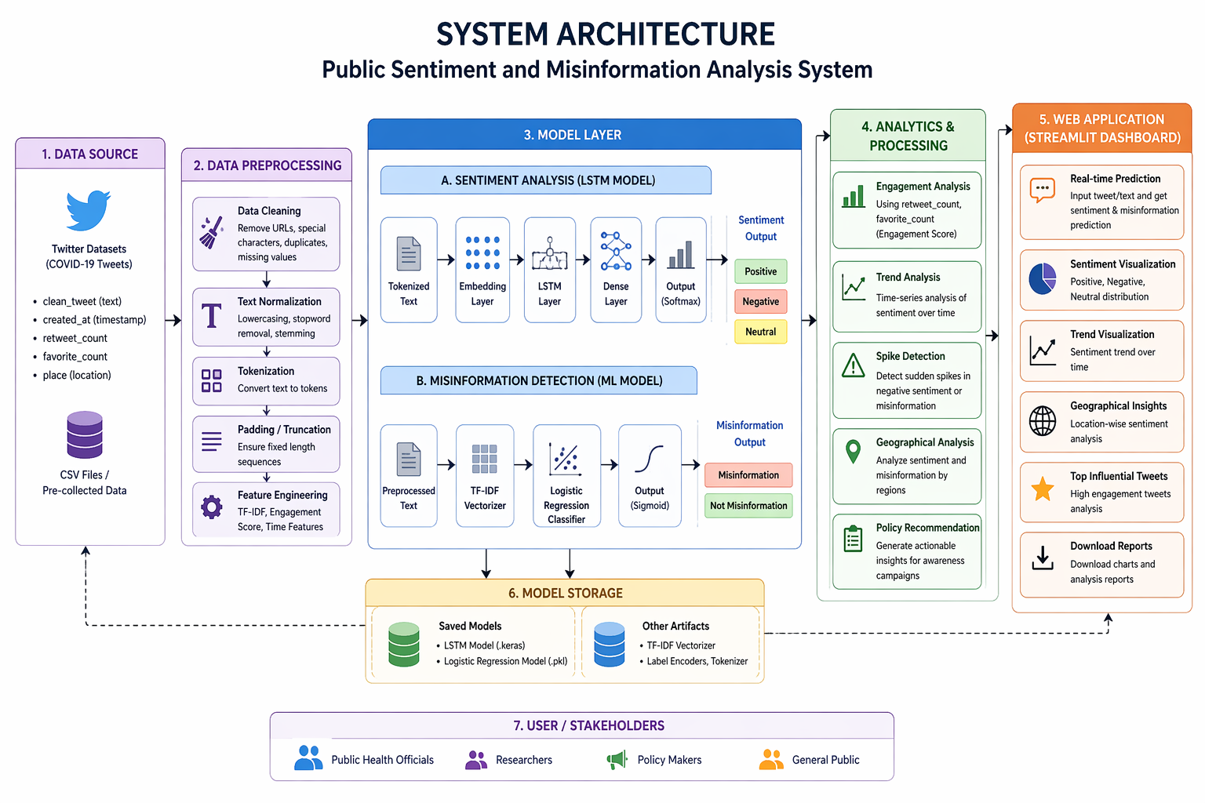
Proposed System

Slide 8
Literature Survey/Existing Systems
Literature Survey / Existing Systems
Existing systems mainly use Machine Learning models with numerical social media data
Some approaches focus only on sentiment analysis without misinformation detection
Deep learning models such as LSTM and BERT are used for text classification tasks
Most systems lack integrated dashboards and real-time analytical capabilities
Limitations or Gaps
Existing methods often ignore combined sentiment and misinformation analysis
Many systems cannot effectively track trends and sudden spikes over time
Transformer-based models require high computational resources for deployment
Limited explainability and lack of practical real-time monitoring solutions
How the Proposed Idea Improves Them
Integrates sentiment analysis and misinformation detection into a single framework
Uses LSTM and TF-IDF with Logistic Regression for efficient text classification
Provides engagement analysis, trend monitoring, and spike detection capabilities
Includes an interactive Streamlit dashboard for real-time visualization and insights

Slide 9
Feasibility Study
Technical Feasibility
The project is feasible using Python, Machine Learning, and NLP technologies
Uses widely supported frameworks such as TensorFlow, Keras, and Scikit-learn
Models can be trained and executed efficiently on standard computing systems
Streamlit enables simple deployment of the interactive web application
Operational Feasibility
The system can support real-time monitoring of public sentiment and misinformation
Suitable for use by policymakers, researchers, and public health authorities
Provides automated analysis, visualization, and trend monitoring capabilities
Interactive dashboard improves usability and decision-making efficiency
Time and Resource Feasibility
The project can be completed within the academic timeline using public datasets
Requires moderate computational resources and standard hardware configurations
Development and deployment can be performed using free or open-source tools
Cost-effective implementation with scalable future enhancement possibilities

Slide 10
Proposed Tools & Technologies
Languages
Python is used for data preprocessing, NLP tasks, model training, and evaluation
Supports Machine Learning, Deep Learning, and visualization development
Frameworks / Libraries
TensorFlow / Keras for LSTM-based sentiment analysis
Scikit-learn for TF-IDF vectorization and Logistic Regression
Pandas and NumPy for data processing and analysis
Plotly / Matplotlib and Streamlit for visualization and dashboard development
Platforms
Developed and tested on Windows, Linux, and Google Colab environments
Can be deployed locally or on cloud platforms such as Streamlit Cloud or AWS
Databases
Uses publicly available Twitter datasets stored in CSV format
No dedicated database required for the current prototype implementation

Slide 11
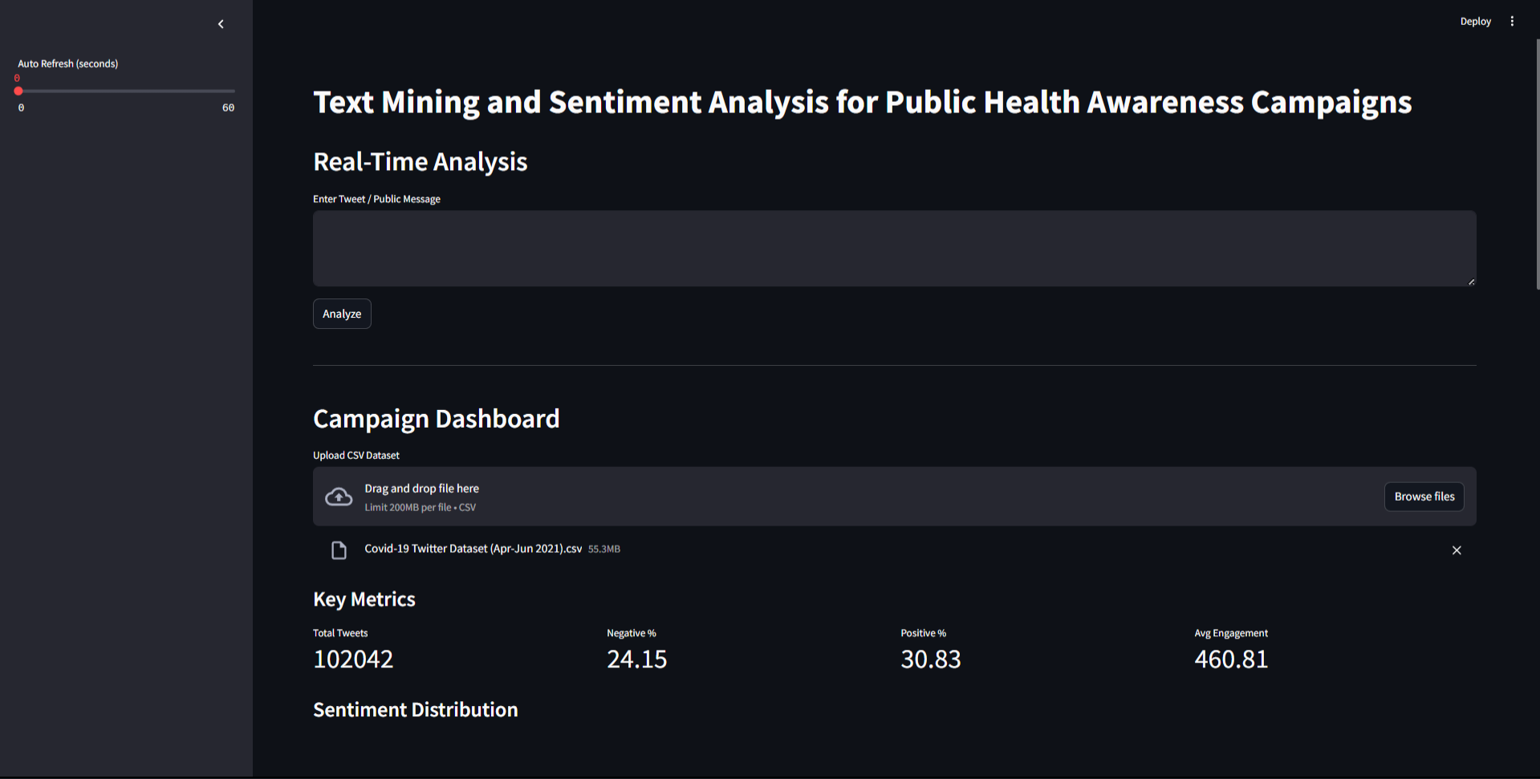
Project Overview

Slide 12
References
Sentiment Analysis and Public Opinion Mining
Deep Learning for Twitter Sentiment Analysis
COVID-19 Misinformation Detection using Machine Learning
Natural Language Processing in Healthcare
LSTM-Based Sentiment Classification Techniques
TF-IDF and Logistic Regression for Text Classification
Social Media Analytics for Public Health Monitoring

